Slide 1
Team Name : Logic Loop
GISTIFY
– “Summarize Smarter”

Slide 2
PROBLEM STATEMENT
Students struggle to keep up with long YouTube educational videos, especially during exam preparation and revision. Manual note-taking is slow, inconsistent, and distracting. There’s a need for a smart tool that turns YouTube content into summaries, notes, and quizzes — helping students learn faster and revise better.

Slide 3
UNIQUE IDEA
YouTube Video Input
↓
Gistify AI Core Engine
(LLM + OpenVINO + TTS)
↓
Multi-Modal Output
↓ ↓
Notes Voice Summary
↓ ↓
Quiz │ Translate│ Glossary
Doubt Resolution Chatbot
Gistify takes a YouTube video link as input and uses its AI core — powered by LLMs, OpenVINO, and TTS — to generate multiple learning outputs.
These include summarized notes, voice-based summaries, auto-generated quizzes, and interactive tools like translation, glossary definitions, and a doubt-resolving chatbot, all designed to make studying from videos faster and smarter.

Slide 4
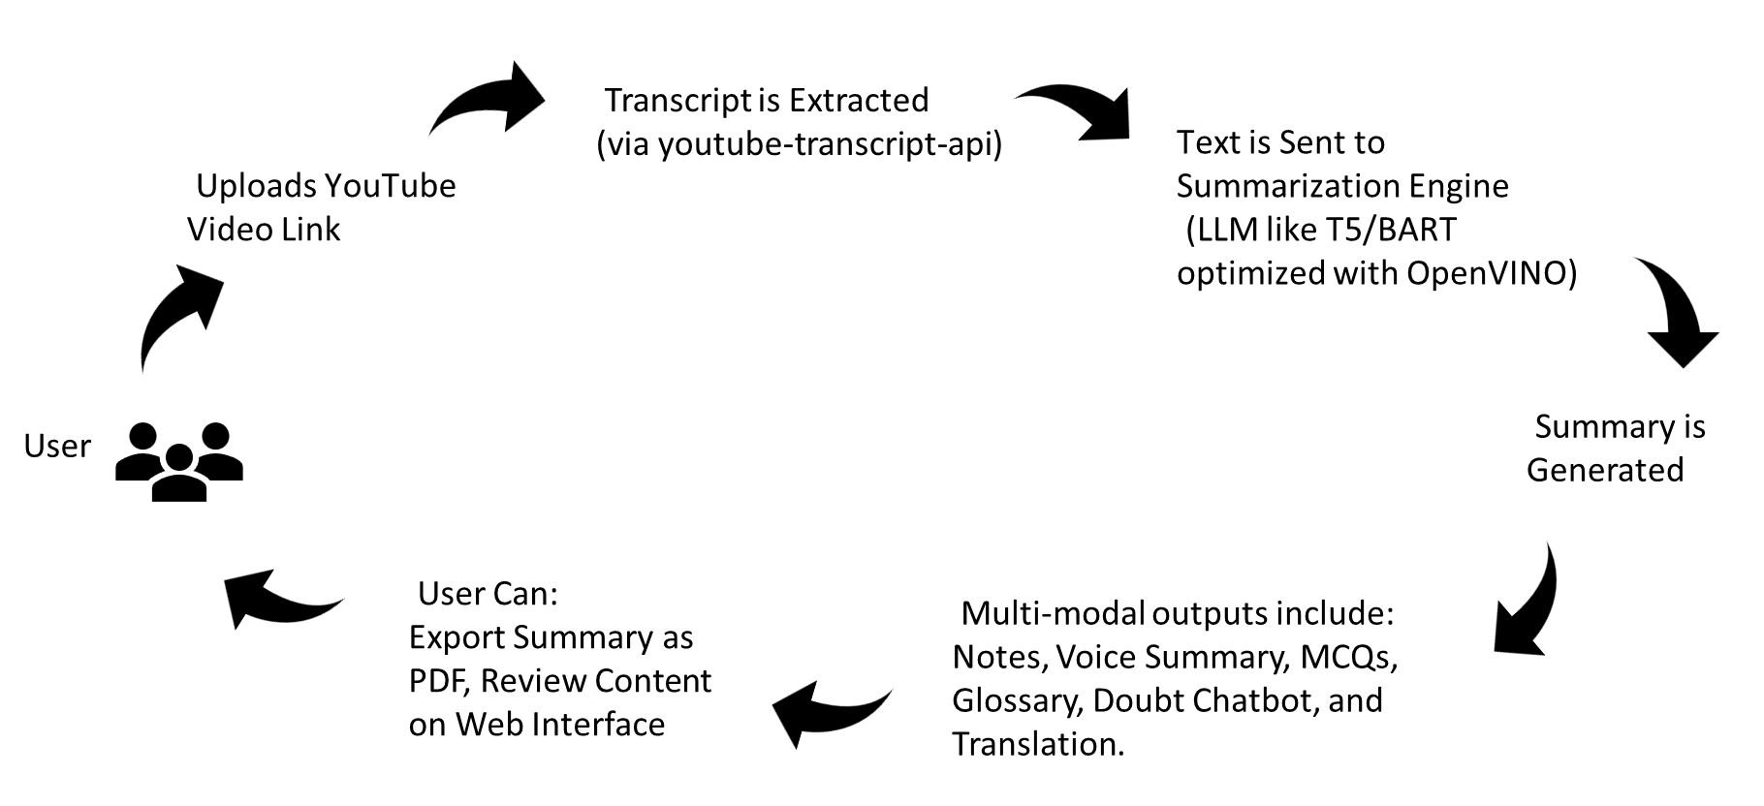
PROCESS FLOW

Slide 5
FEATURES OFFERED
YouTube Video Summarization
Document Summarization (PDF)
Text-to-Speech Voice Summary
MCQ Generator
Doubt Solver Chatbot
Glossary Term Extractor
Multilingual Translation
PDF Export of Summaries

Slide 6
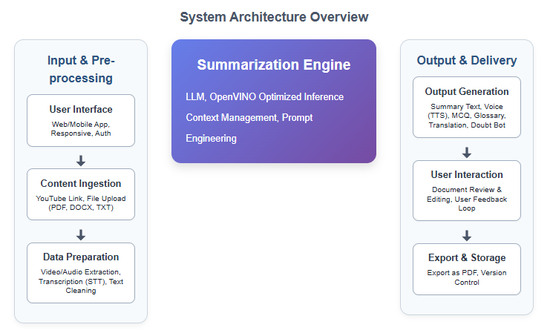
ARCHITECTURE DIAGRAM

Slide 7
TECHNOLOGIES USED
• User Interface (UI) Layer
Web Technologies: HTML, CSS, Streamlit / Flask
Design: Canva (for UI mockups and assets)
• Backend & API Server
Language: Python
Framework: Flask / FastAPI
File Handling: PyMuPDF, python-docx, youtube-transcript-api
API: RESTful API
• Summarization & AI Layer
LLMs: T5, BART (via Hugging Face Transformers)
Optimization: Intel OpenVINO Toolkit
Inference: IR format models for CPU efficiency
• Speech & Audio
TTS Engines: gTTS, pyttsx3
• Quiz & Glossary Generation
MCQ: Prompt-based generation using local LLMs
Glossary: Term extraction + definitions (rule-based + AI-enhanced)
• Doubt Resolution Module
Model: Distilled SQuAD or custom Q&A LLM
Libraries: Transformers, LangChain (if used)
• Translation
Models: MarianMT / mBART (Hugging Face)

Slide 8
TEAM CONTRIBUTION
Shamsu Nisha N – Backend Developer (Team Lead)
Developed core backend functionalities including MCQ generation, glossary, and chatbot integration.
Sharmila D – AI & System Designer
Led the architecture design and integrated OpenVINO with LLMs for efficient video summarization.
Tharani V S – UI/UX Developer
Designed and implemented the user interface, ensuring a seamless and intuitive user experience.

Slide 9
CONCLUSION
Gistify combines the power of Generative AI, Edge Optimization with OpenVINO, and education-focused intelligence to transform how students consume, understand, and revise content.
It makes learning smarter, multilingual, interactive, and accessible — even on basic devices.

